Slide 1
Java EE Training Course
XML and JSON
Notes:
ATS Application Programming: Java Programming
Brown Bag: XML
© Accenture 2005 All Rights Reserved
Course Code #Z16325

Slide 2
Agenda
JAXB
Generation by XSD
XML Marshalling and unmarshalling
Spring OXM
JSON format
JSON Marshalling and unmarshalling (Gson)
Notes:
ATS Application Programming: Java Programming
Brown Bag: XML
© Accenture 2005 All Rights Reserved
Course Code #Z16325

Slide 3
Introduction to JAXB
Java Architecture for XML Binding (JAXB) provides a fast and convenient way to bind XML schemas and Java representations
JAXB provides two main features:
  To marshal Java objects into XMLSupport for binding Java-to-XML
  To unmarshal XML back into Java objects
Actual versions
  Java SE 7: JAXB 2.2.3 (JSR 222, maintenance release 2)
  Java SE 6: JAXB 2.0 (JSR 222)
Notes:
Java Architecture for XML Binding (JAXB) позволяет Java разработчикам ставить в соответствие Java классы и XML представления
JAXB предоставляет две основные возможности: маршаллирование Java объектов в XML и наоборот, то есть демаршализация из XML обратно в Java объект
JAXB является частью Java SE платформы и является одной из API в Java EE платформе
ATS Application Programming: Java Programming
Brown Bag: XML
© Accenture 2005 All Rights Reserved
Course Code #Z16325

Slide 4
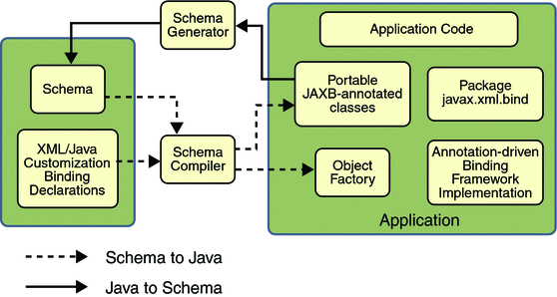
JAXB Architecture
Notes:
A JAXB implementation consists of the following architectural components:
Schema compiler: Binds a source schema to a set of schema-derived program elements. The binding is described by an XML-based binding language.
Schema generator: Maps a set of existing program elements to a derived schema. The mapping is described by program annotations.
Binding runtime framework: Provides unmarshalling (reading) and marshalling (writing) operations for accessing, manipulating, and validating XML content using either schema-derived or existing program elements.
ATS Application Programming: Java Programming
Brown Bag: XML
© Accenture 2005 All Rights Reserved
Course Code #Z16325

Slide 5
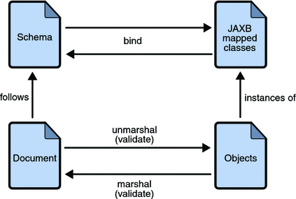
The JAXB Binding Process
Notes:
The general steps in the JAXB data binding process are:
Generate classes: An XML schema is used as input to the JAXB binding compiler to generate JAXB classes based on that schema.
Compile classes: All of the generated classes, source files, and application code must be compiled.
Unmarshal: XML documents written according to the constraints in the source schema are unmarshalled by the JAXB binding framework. Note that JAXB also supports unmarshalling XML data from sources other than files and documents, such as DOM nodes, string buffers, SAX sources, and so forth.
Generate content tree: The unmarshalling process generates a content tree of data objects instantiated from the generated JAXB classes; this content tree represents the structure and content of the source XML documents.
Validate (optional): The unmarshalling process involves validation of the source XML documents before generating the content tree. Note that if you modify the content tree in Step 6, you can also use the JAXB Validate operation to validate the changes before marshalling the content back to an XML document.
Process content: The client application can modify the XML data represented by the Java content tree by using interfaces generated by the binding compiler.
Marshal: The processed content tree is marshalled out to one or more XML output documents. The content may be validated before marshalling.
ATS Application Programming: Java Programming
Brown Bag: XML
© Accenture 2005 All Rights Reserved
Course Code #Z16325

Slide 6
Default data type bindings
XML Schema Type | Java Data Type
xsd:string | java.lang.String
xsd:int | int
xsd:long | long
xsd:short | short
xsd:decimal | java.math.BigDecimal
xsd:float | float
xsd:double | double
xsd:boolean | boolean
xsd:byte | byte
xsd:integer | java.math.BigInteger
xsd:date | javax.xml.datatype.XMLGregorianCalendar

Slide 7
JAXB annotated class example
@XmlRootElement
public class Customer {
String name;
int age;
int id;
@XmlElement
public void setName(String name) {
this.name = name;
}
@XmlElement
public void setAge(int age) {
this.age = age;
}
@XmlAttribute
public void setId(int id) {
this.id = id;
}
}

Slide 8
XML Marshalling
Convert Object to XML
File file = new File("C:\\customer.xml");
JAXBContext jaxbContext = JAXBContext.newInstance(Customer.class);
Marshaller jaxbMarshaller = jaxbContext.createMarshaller();
// output pretty printed
jaxbMarshaller.setProperty(Marshaller.JAXB_FORMATTED_OUTPUT, true);
jaxbMarshaller.marshal(customer, file);

Slide 9
XML Unmarshalling
Convert XML to Object
File file = new File("C:\\customer.xml");
JAXBContext jaxbContext = JAXBContext.newInstance(Customer.class);
Unmarshaller jaxbUnmarshaller = jaxbContext.createUnmarshaller();
Customer customer = (Customer) jaxbUnmarshaller.unmarshal(file);

Slide 10
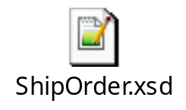
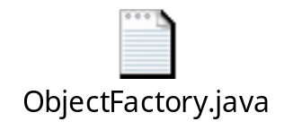
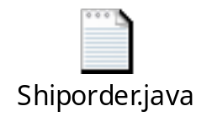
Generation by XSD
The tool "xjc" can be used to convert XML Schema to class representations.
Using JAXB xjc tooling to generate JAXB classes from an XML schema file:
  Copy the ShipOrder.xsd schema file to a directory
  Open a command prompt
  Run the JAXB schema compiler, xjc command from the directory where the schema file is located:
  xjc ShipOrder.xsd
  Running the xjc command generates the following JAXB Java files:
Notes:
@XmlAccessorType(XmlAccessType.FIELD) задает, что доступ будет осуществляться непосредственно к полям (не нужно делать getter-ов)
@XmlType задает в каком порядке добавлять поля класса в выходной документ
ATS Application Programming: Java Programming
Brown Bag: XML
© Accenture 2005 All Rights Reserved
Course Code #Z16325

Slide 11
Spring OXM
The Spring’s Object/XML Mapping, is converting Object to XML or vice verse
The spring-oxm module provides an abstraction layer that supports Object/XML mapping implementations such as JAXB, Castor, XMLBeans, JiBX and XStream.
Benefits of using Spring for your O/X mapping needs are:
Ease of configuration
Spring's bean factory makes it easy to configure marshallers, without needing to construct JAXB context, JiBX binding factories, etc
Consistent Interfaces
Spring's O/X mapping operates through two global interfaces: the Marshaller and Unmarshaller interface
Consistent Exception Hierarchy
Runtime exceptions wrap the original exception so no information is lost

Slide 12
Spring OXM Configuration
<beans>
<bean id="XMLConverter" class=“com.accenture.test.XMLConverter">
<property name="marshaller" ref="castorMarshaller" />
<property name="unmarshaller" ref="castorMarshaller" />
</bean>
<bean id="XMLConverter" class="org.springframework.oxm.castor.CastorMarshaller"/>
</beans>

Slide 13
Spring OXM XMLConverter
public class XMLConverter {
…….
private Marshaller marshaller;
private Unmarshaller unmarshaller;
……..
public void convertFromObjectToXML(Object object, String filepath)
throws IOException {
…………………………
os = new FileOutputStream(filepath);
getMarshaller().marshal(object, new StreamResult(os));
…………………………
}
public Object convertFromXMLToObject(String xmlfile) throws IOException {
…………………………
is = new FileInputStream(xmlfile);
return getUnmarshaller().unmarshal(new StreamSource(is));
…………………………
}
………..
}

Slide 14
Spring OXM Usage
ApplicationContext appContext = new ClassPathXmlApplicationContext("App.xml");
XMLConverter converter = (XMLConverter) appContext.getBean("XMLConverter");
Customer customer = new Customer();
customer.setName(“John");
customer.setAge(30);
customer.setFlag(true);
customer.setAddress("This is address");
//from object to XML file
converter.convertFromObjectToXML(customer, "customer.xml");
//from XML to object
Customer customer2 = (Customer)converter.convertFromXMLToObject("customer.xml");

Slide 15
What is JSON?
Stands for JavaScript Object Notation
It is a lightweight data-interchange format
JSON is an easier-to-use alternative to XML:
JSON is language independent
JSON is "self-describing" and easy to understand
JSON is an easier-to-use alternative to XML
JSON is a syntax for storing and exchanging data
The JSON format is syntactically identical to the code for creating JavaScript objects
Notes:
JSON is language independent. JSON uses JavaScript syntax, but the JSON format is text only, just like XML. Text can be read and used as a data format by any programming language.
Because of this similarity, instead of using a parser (like XML does), a JavaScript program can use standard JavaScript functions to convert JSON data into native JavaScript objects.
ATS Application Programming: Java Programming
Brown Bag: XML
© Accenture 2005 All Rights Reserved
Course Code #Z16325

Slide 16
JSON vs XML
JSON
  {"employees":[
  {
  "firstName":"John", "lastName":"Doe“
  },
  {
  "firstName":"Anna", "lastName":"Smith“
  },
  {
  "firstName":"Peter", "lastName":"Jones“
  }
  ]}
XML
<employees>
<employee>
<firstName>John</firstName>
<lastName>Doe</lastName>
</employee>
<employee>
<firstName>Anna</firstName>
<lastName>Smith</lastName>
</employee>
<employee>
<firstName>Peter</firstName>
<lastName>Jones</lastName>
</employee>
</employees>

Slide 17
Google Gson
Gson is a Java library that can be used to convert Java Objects into their JSON representation.
It can also be used to convert a JSON string to an equivalent Java object.
Goals for Gson:
  Provide easy to use mechanisms like toString() and constructor to convert Java to JSON and vice-versa
  Allow custom representations for objects
  Support arbitrarily complex objects
  Generate compact and readable JSON output

Slide 18
Gson Serialization and Deserialization
Customer customer = new Customer();
customer.setName(“John");
customer.setAge(30);
customer.setFlag(true);
customer.setAddress("This is address");
// Serialization
Gson gson = new Gson();
String json = gson.toJson(customer );
//Deserialization
Customer customer = gson.fromJson(json, Customer.getClass());

Slide 19
Gson Servlet Example
public class JsonParserServlet extends HttpServlet {
@Override
protected void doPost(HttpServletRequest request, HttpServletResponse response)
throws ServletException, IOException {
Gson gson = new Gson();
StringBuilder sb = new StringBuilder();
String s;
while ((s = request.getReader().readLine()) != null) {
sb.append(s);
}
Customer customer = (Customer) gson.fromJson(sb.toString(), Customer.class);
…………
response.getOutputStream().print(gson.toJson(status));
response.getOutputStream().flush();
}
}

Slide 20
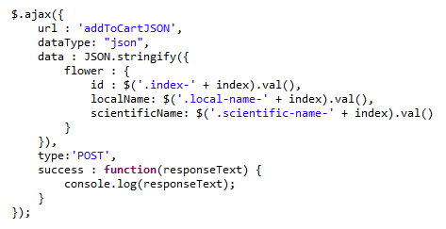
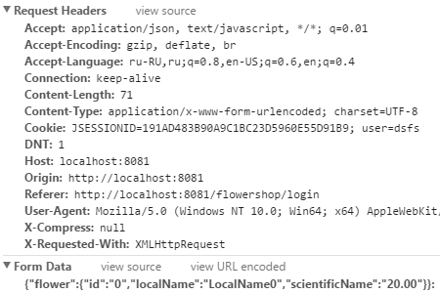
jQuery Ajax JSON

Slide 21
Self study materials
Customizing Generated Classes and Java Program Elements
https://docs.oracle.com/javase/tutorial/jaxb/intro/customize.html
Gson Servlet
http://edwin.baculsoft.com/2011/11/how-to-create-a-simple-servlet-to-handle-json-requests/
Gson User Guide
https://github.com/google/gson/blob/master/UserGuide.md
jQuery Ajax
http://api.jquery.com/jquery.ajax/

Slide 22
Activity
Add maven dependencies:
  spring-oxm 4.2.0.RELEASE
  Castor 1.2
  xercesImpl 2.8.1
Create UserMarshgallingServiceImpl service which can convert given user object to XML and put file with XML content to target file directory:
  Target directory location should be set in property configuration file
  Use org.springframework.oxm.castor.CastorMarshaller to marshall user object to XML
3. Call UserMarshgallingServiceImpl method after each user successful registration

Slide 23
Questions:
???
Notes:
ATS Application Programming: Java Programming
Brown Bag: XML
© Accenture 2005 All Rights Reserved
Course Code #Z16325

